Slide 1
Fundamentals of Machine Learning
Machine Learning is the science of programming computers so they can learn from data.
Machine Learning is the field of study that gives computers the ability to learn without being explicitly programmed.
A computer program is said to learn from experience E with respect to some task T and some performance measure P, if its performance on T, as measured by P, improves with experience E.

Slide 2
Example
Spam filter is a Machine Learning program that can learn to flag spam given examples of spam emails (e.g., flagged by users) and examples of regular (nonspam, also called “ham”) emails.
The examples that the system uses to learn are called the training set. Each training example is called a training instance (or sample).
In this case, the task T is to flag spam for new emails, the experience E is the training data, and the performance measure P needs to be defined; for example, you can use the ratio of correctly classified emails.
This particular performance measure is called accuracy and it is often used in classification tasks.
If you just download a copy of Wikipedia, your computer has a lot more data, but it is not suddenly better at any task. Thus, it is not Machine Learning.

Slide 3
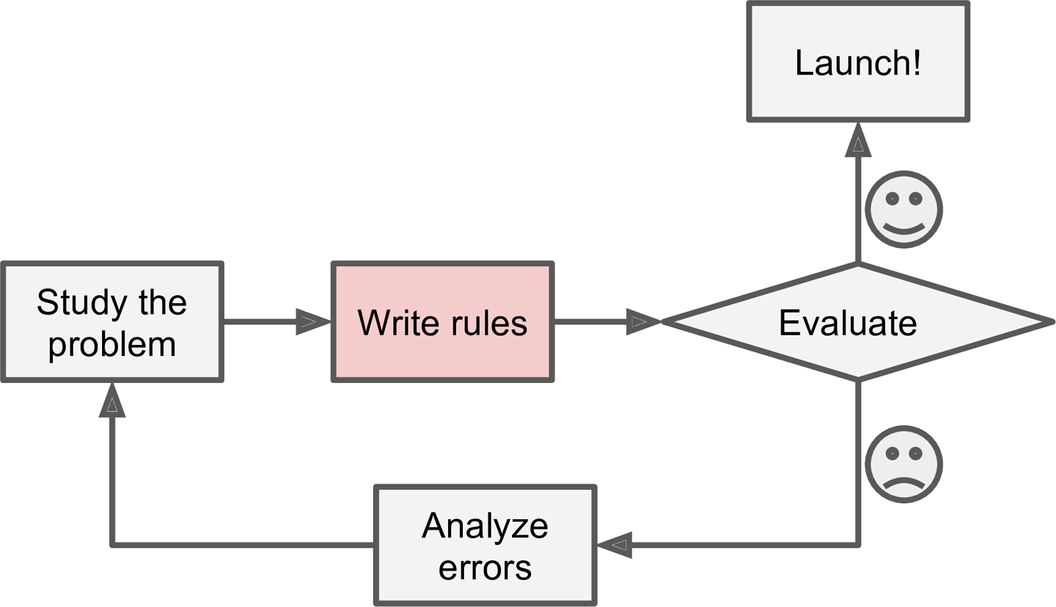
The traditional approach

Slide 4
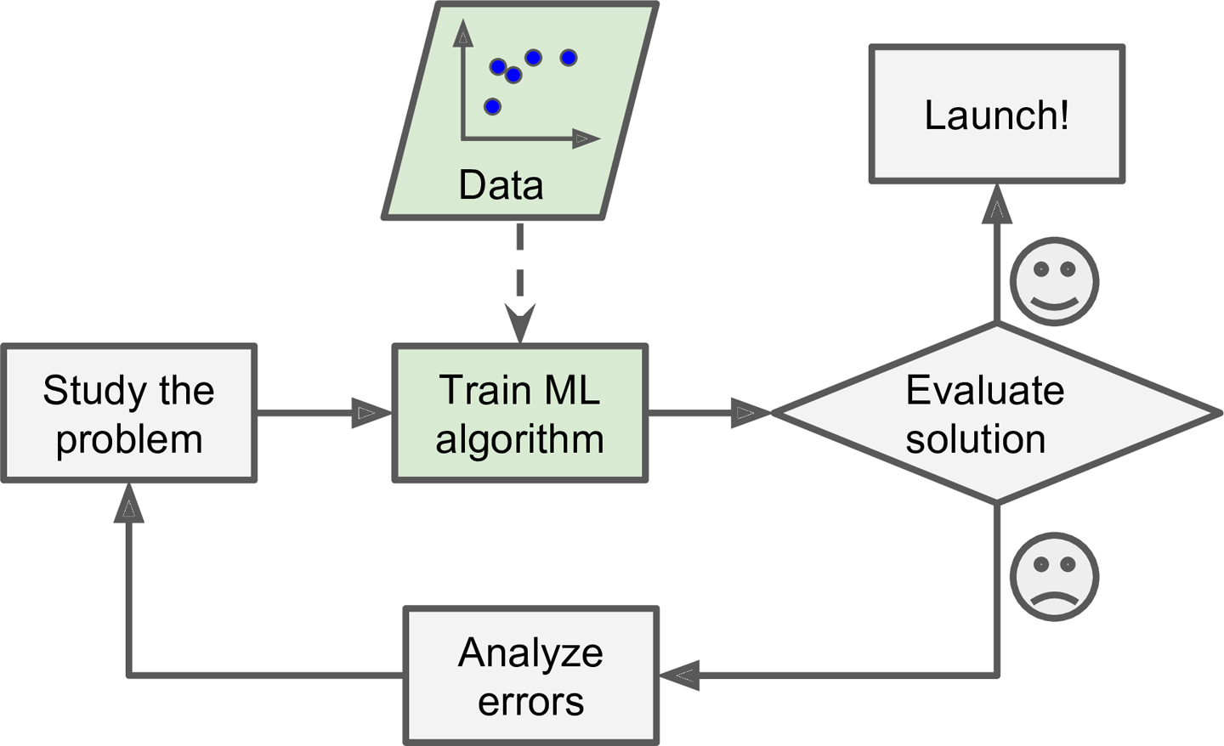
Use of Machine Learning

Slide 5
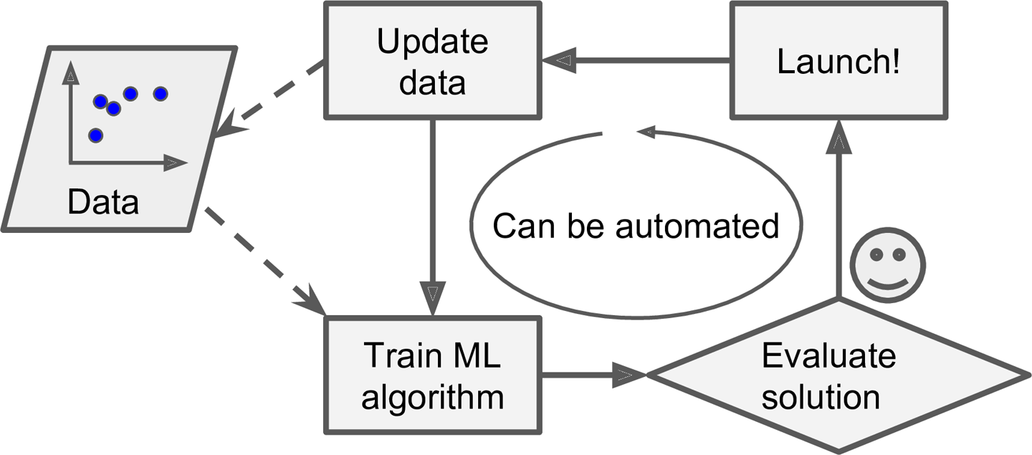
Automatic Adaptation

Slide 6
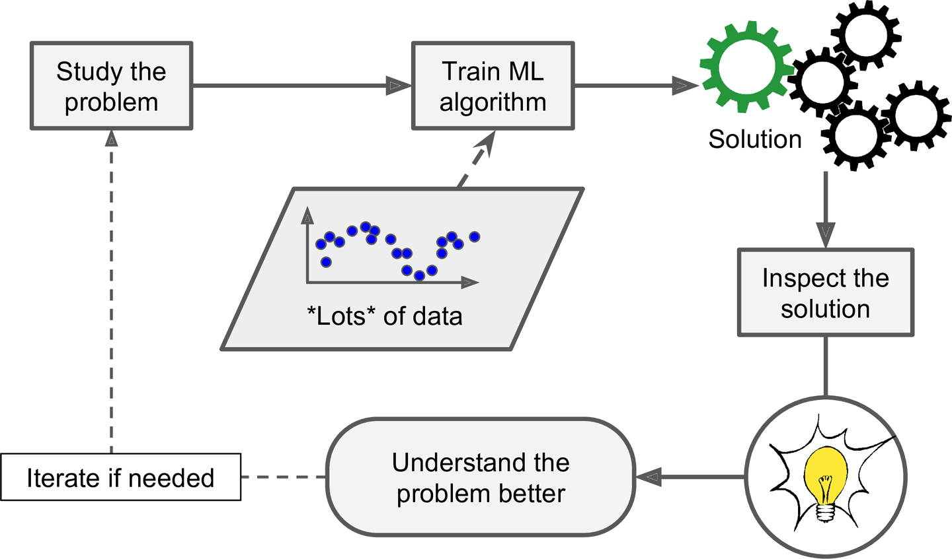
Machine Learning helps Humans Learn

Slide 7
Types of Machine Learning Systems
Whether or not they are trained with human supervision(supervised, unsupervised, semi supervised, and Reinforcement Learning)
Whether or not they can learn incrementally on the fly (online versus batch learning)
Whether they work by simply comparing new data points to known data points, or instead detect patterns in the training data and build a predictive model, much like scientists do (instance-based versus model-based learning)

Slide 8
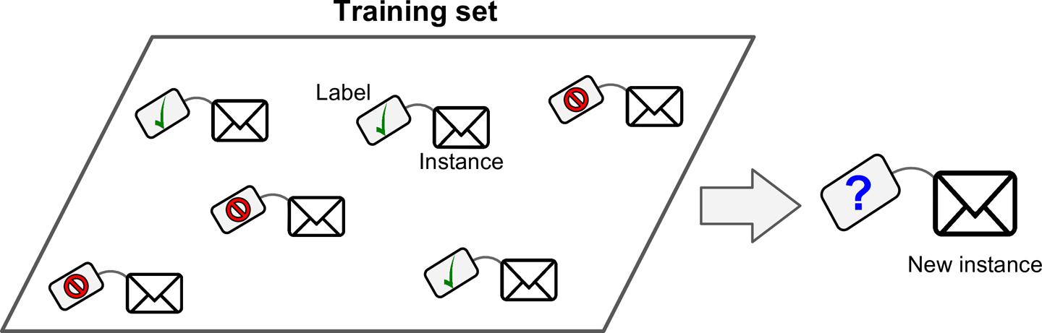
Supervised learning
Examples: k-Nearest Neighbors, Linear Regression, Logistic Regression, Support Vector Machines (SVMs) , Decision Trees and Random Forests, Neural networks2

Slide 9
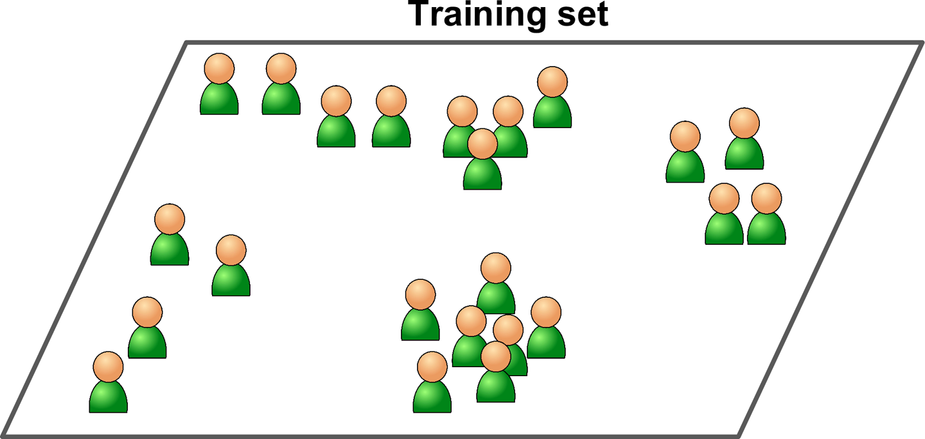
Unsupervised learning
Data is unlabeled
Examples: Clustering -- k-Means, Hierarchical Cluster Analysis (HCA), Visualization and dimensionality reduction -- Principal Component Analysis (PCA), Anomaly detection, Association rule learning -- Apriori

Slide 10
A related task is dimensionality reduction, in which the goal is to simplify the data without losing too much information.
One way to do this is to merge several correlated features into one. For example, a car’s mileage may be very correlated with its age.
So the dimensionality reduction algorithm will merge them into one feature that represents the car’s wear and tear. This is called feature extraction.

Slide 11
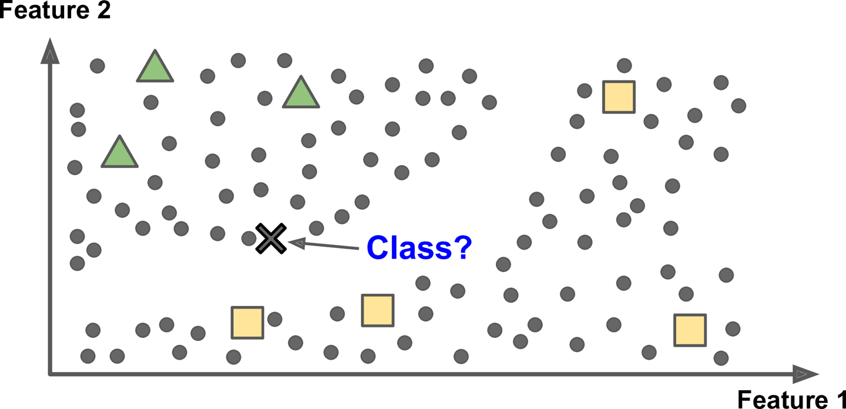
Semi supervised learning
Partially labeled training data i.e. usually a lot of unlabeled data and a little bit of labeled data.

Slide 12
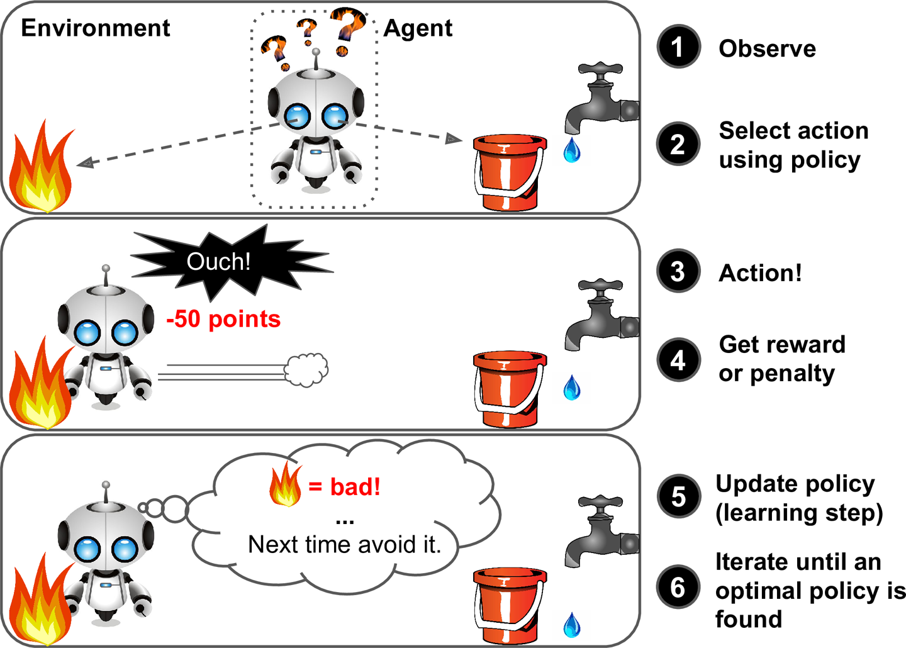
Reinforcement Learning

Slide 13
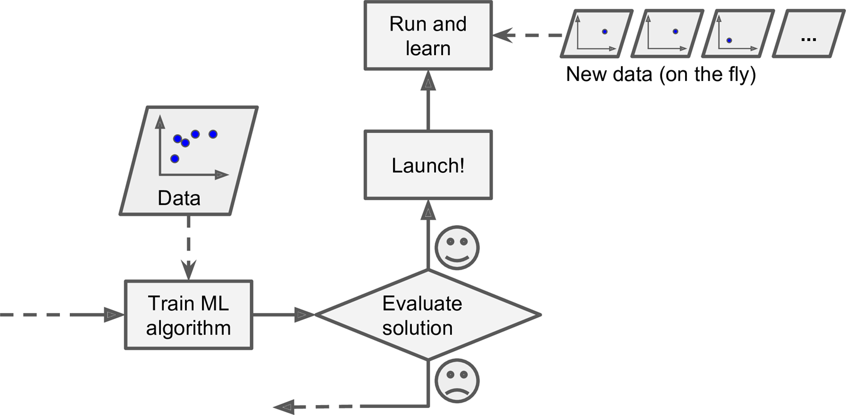
online learning

Slide 14
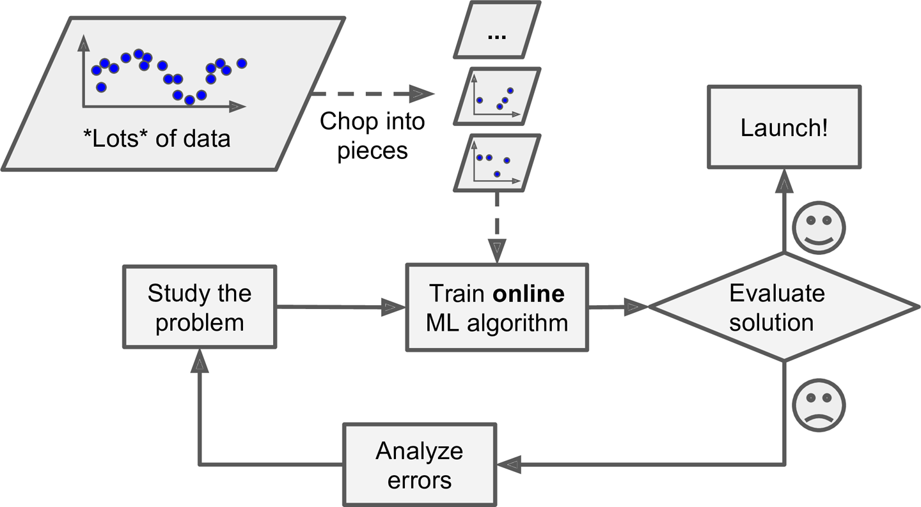
Online Learning with lots of data

Slide 15
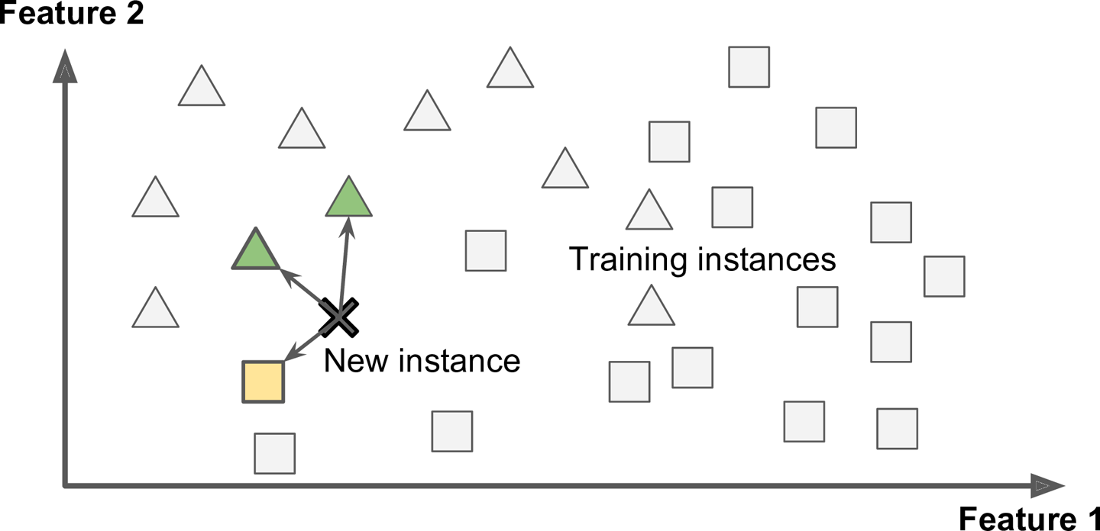
Instance Based Learning

Slide 16
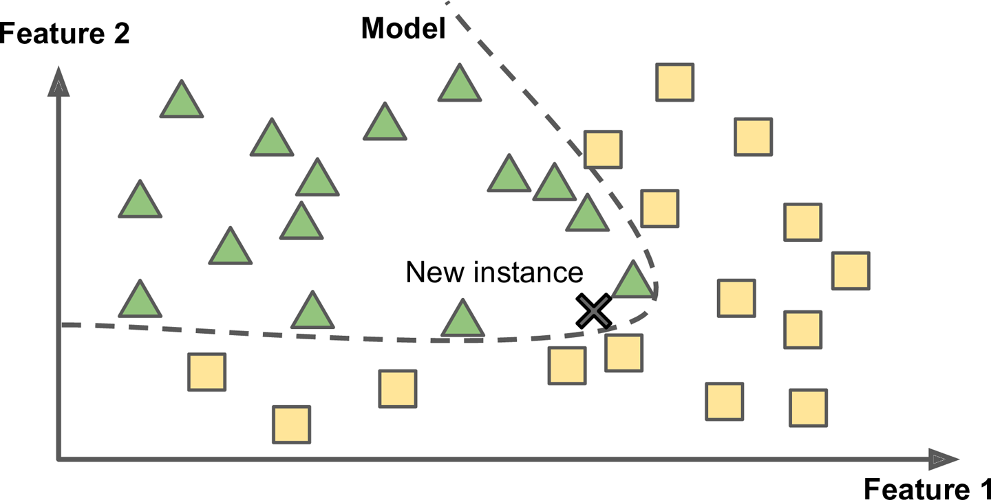
Model Based Learning

Slide 17
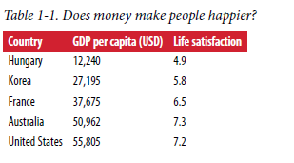
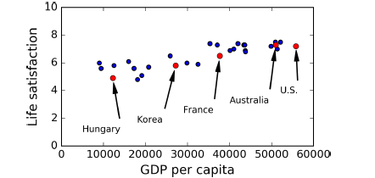

Slide 18

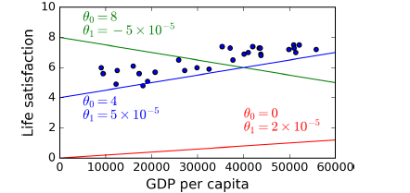

Slide 19
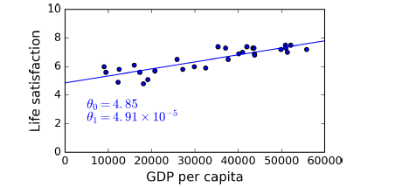

Slide 20
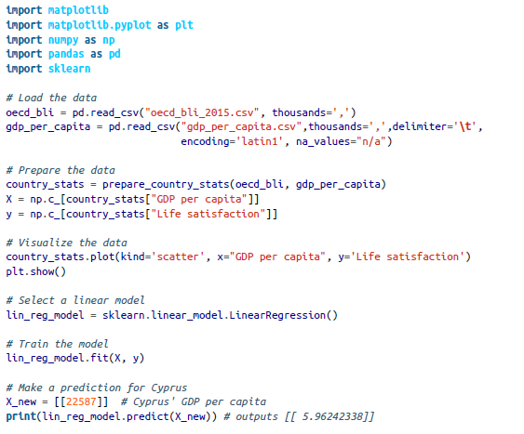

Slide 21
Instance-based learning algorithm : Slovenia has the closest GDP per capita to that of Cyprus ($20,732), and since the OECD’ life satisfaction is 5.7, you would have predicted a life satisfaction of 5.7 for Cyprus.
If you look at the two next closest countries, you will find Portugal and Spain with life satisfactions of 5.1 and 6.5, respectively. Averaging these three values, you get 5.77, which is pretty close to your model-based prediction. This simple algorithm is called k-Nearest Neighbors regression (in this example, k = 3).
Replacing the Linear Regression model with k-Nearest Neighbors regression in the previous code is as simple as replacing this line:
clf = sklearn.linear_model.LinearRegression()
with this one:
clf= sklearn.neighbors.KNeighborsRegressor(n_neighbors=3)

Slide 22
Challenges
Insufficient Quantity of Training Data
Non representative Training Data
Poor-Quality Data
Irrelevant Features
Overfitting the Training Data
Underfitting the Training Data

Slide 23
Insufficient Quantity of Training Data
It takes a lot of data for most Machine Learning algorithms to work properly.
Even for very simple problems you typically need thousands of examples, and for complex problems such as image or speech recognition you may need millions of examples (unless you can reuse parts of an existing model).

Slide 24
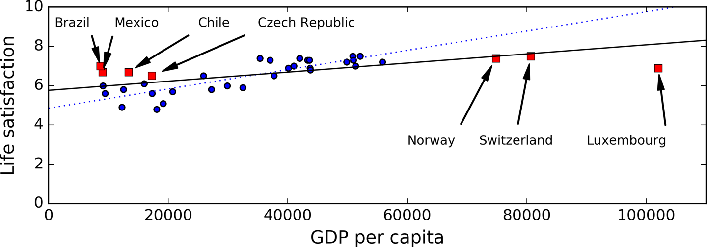
Non Representative Training Data

Slide 25
It is crucial to use a training set that is representative of the cases you want to generalize to.
If the sample is too small, you will have sampling noise i.e., nonrepresentative data.
Even very large samples can be non representative if the sampling method is flawed. This is called sampling bias.

Slide 26
Poor Quality Data
If some instances are clearly outliers, it may help to simply discard them or try to fix the errors manually.
If some instances are missing a few features (e.g., 5% of your customers did not specify their age)
you must decide whether you want to ignore this attribute altogether, ignore these instances, fill in the missing values (e.g., with the median age), or train one model with the feature and one model without it, and so on.

Slide 27
Irrelevant Features
A critical part of the success of a Machine Learning project is coming up with a good set of features to train on. This process is called feature engineering.
Feature selection: selecting the most useful features to train on among existing features.
Feature extraction: combining existing features to produce a more useful one.
Creating new features by gathering new data.

Slide 28
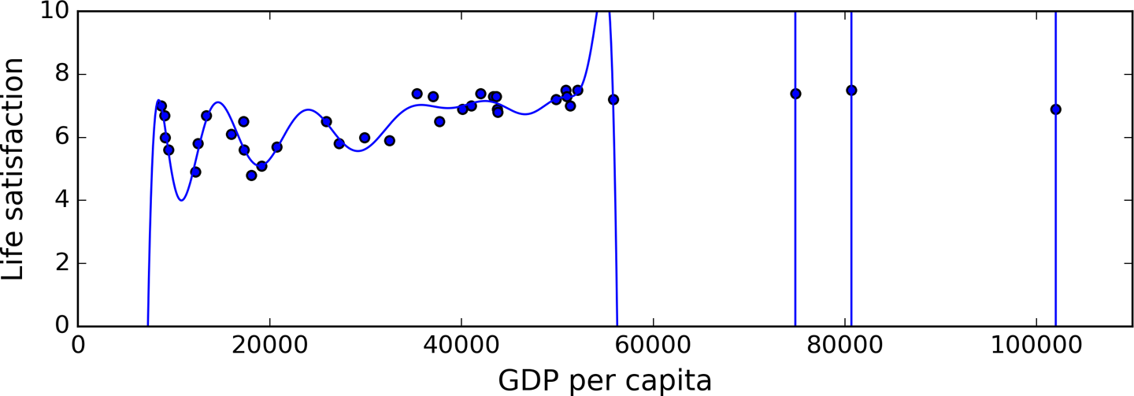
Overfitting the Training Data
Overfitting: The model performs well on the training data, but it does not generalize well.

Slide 29
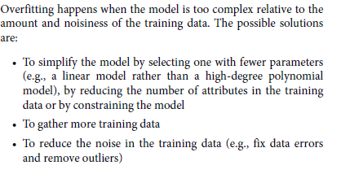

Slide 30
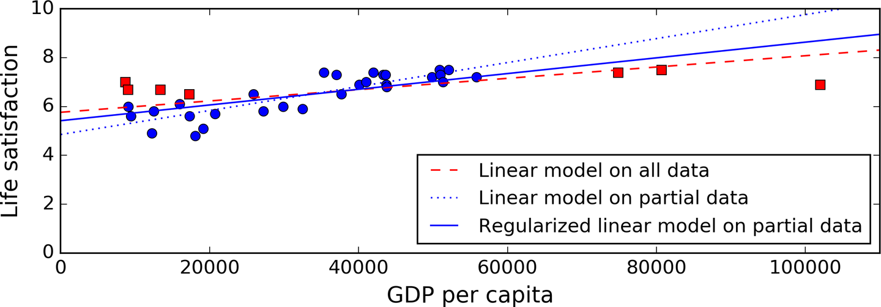
Constraining a model to make it simpler and reduce the risk of overfitting is called regularization.
The amount of regularization to apply during learning can be controlled by a hyperparameter. A hyperparameter is a parameter of a learning algorithm (not of the model)

Slide 31
Underfitting the Training Data
Underfitting is the opposite of overfitting: it occurs when your model is too simple to learn the underlying structure of the data.
The main options to fix this problem are:
• Selecting a more powerful model, with more parameters
• Feeding better features to the learning algorithm (feature engineering)

Slide 32
Testing and Validating
Split data in to two sets: Training set and test set.
Error rate on new cases is called generalization error.
If the training error is low but the generalization error is high, it means that your model is overfitting the training data.
Cross validation – Split training set in to complementary subsets
model is trained against a different combination of these subsets and validated against the remaining parts.

Slide 33
Working with Real data
Popular data repositories:
UC Irvine Machine Learning Repository
Kaggle datasets
Amazon’s AWS datasets
Meta portals (they list open data repositories):
http://dataportals.org/
http://opendatamonitor.eu/
http://quandl.com/
Other pages listing many popular open data repositories:
Wikipedia’s list of Machine Learning datasets
Quora.com question
Datasets subreddit

Slide 34
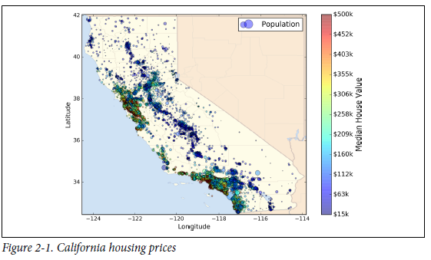
Loot at the Big Picture

Slide 35
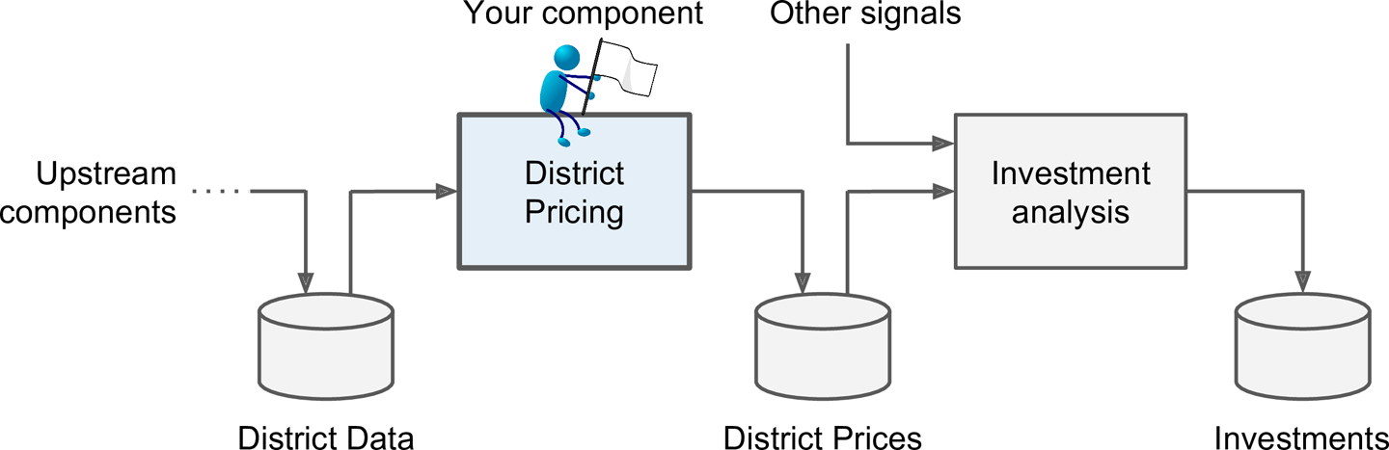
Machine Learning Pipeline for Real Estate Investments

Slide 36
Frame the Problem
A sequence of data processing components is called a data pipeline
First, you need to frame the problem: is it supervised, unsupervised, or Reinforcement Learning?
Is it a classification task, a regression task, or something else?
Should you use batch learning or online learning techniques?

Slide 37
Select a Performance Measure
A typical performance measure for regression problems is the Root Mean Square Error (RMSE).

Slide 38
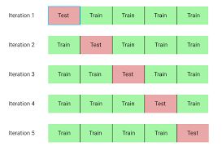

Slide 39
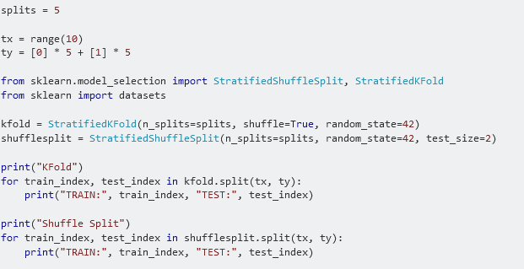
Stratified shuffle split

Slide 40
